Slide 1
Unit 4 History And Traditions
第3课时

Slide 2
What’s in a name?
1. How do most people call the UK?
2. What are the flags of these four countries?
3. What did the Normans do after they conquered England?

Slide 3
What’s in a name?
1. How do most people call the UK?
Most people just use the shortened name: “the
United Kingdom” or “the UK”.

Slide 4
What’s in a name?
2. What are the flags of these four countries?
They use the same flag known as the Union
Jack.

Slide 5
What’s in a name?
3. What did the Normans do after they conquered
England?
They had castles built and had the legal system
changed.”

Slide 6
Past participle 过去分词
1. Most people just use the shortened name: “the United Kingdom” or “the UK”.
2. They use the same flag known as the Union Jack.
3. They had castles built and had the legal system changed.

Slide 7
attribute 定语
pre-modifier 前置修饰语
Past participle
Most people just use the shortened name: “the United Kingdom” or “the UK”.
Full name:“The United Kingdom of Great Britain and Northern Ireland”

Slide 8
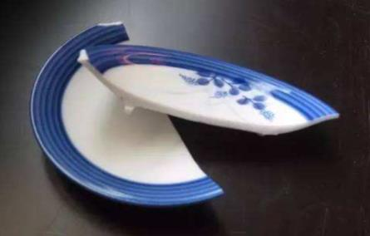
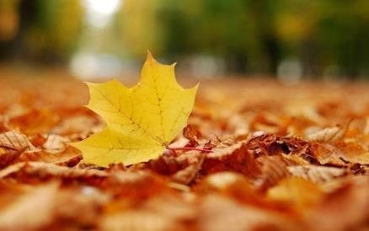
Past participle as the pre-modifier
a broken plate
a fallen leaf

Slide 9
Past participle as the pre-modifier
a broken plate, the spoken language
a fallen leaf, a retired teacher
transitive verbs 及物动词
intransitive verbs 不及物动词

Slide 10

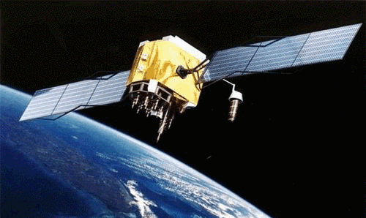
Past participle as the pre-modifier
a newly-built house
a man-made satellite

Slide 11
Past participle as the pre-modifier
Soldiers that are trained well are well-trained soldiers.
A card that is made by hand is a card.
hand-made
A company that is developed quickly is a
company.
quickly-developed

Slide 12
Past participle as the pre-modifier
a broken plate, a fallen leaf
a newly-built house, a man-made satellite

Slide 13

attribute 定语
post-modifier 后置修饰语
Past participle
They use the same flag known as the Union Jack.
They use the same flag which is known as the
Union Jack.

Slide 14
Past participle as the post-modifier
The flowers which are planted along the road are beautiful.
The flowers are beautiful.
The castle which is surrounded by trees is famous.
The castle is famous.
planted along the road
surrounded by trees

Slide 15
Complete the phrases in the right column by using the past participles in the left column.
tired
tired visitors | visitors of the long wait
a well-organised trip | a trip well by my workplace
beautifully dressed stars | stars beautifully at the event
organised
dressed

Slide 16
Complete the sentences using the past participles of the verbs as the attribute.
1. The first engine (drive) by steam was invented by James Walt, an inventor, engineer, and chemist.
driven
2. It’s dangerous for the villagers to drink from wells
(pollute) with poisonous chemicals.
polluted

Slide 17
Complete the sentences using the past participles of the verbs as the attribute.
packed
3. Rosemary shares her (pack) lunch with two friends every day.
4. Westminster Abby is a typical Gothic church,
(complete) in the 10th century.
completed

Slide 18
Complete the sentences using the past participles of the verbs as the attribute.
5. These are English textbooks specially (design) for primary school students.
designed
6. In the car park of the National Museum there are parking spaces (reserve预留) for people with disabilities.
reserved

Slide 19
Past participle as the object complement
They had castles built and had the legal system changed.

Slide 20
Past participle as the object complement
They had castles built and had the legal system changed.
have sb./sth. done
object
宾语
object complement
宾语补足语

Slide 21
Read the sentence and mark the -ed form as the object complement.
1. Judy and I had our car parked in an underground car park near Trafalgar Square, where we could get our car battery charged.

Slide 22
Read the sentence and mark the -ed form as the object complement.
1. Judy and I had our car parked in an underground car park near Trafalgar Square, where we could get our car battery charged.
have sb./sth. done

Slide 23
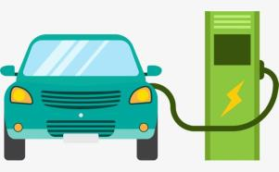
Read the sentence and mark the -ed form as the object complement.
1. Judy and I had our car parked in an underground car park near Trafalgar Square, where we could get our car battery charged.
get sb./sth. done

Slide 24
Read the sentence and mark the -ed form as the object complement.
2. Judy had her eyes fixed on Van Gogh’s Sunflowers. It was hard to approach the painting as there were so many people around.

Slide 25
Read the sentence and mark the -ed form as the object complement.
2. Judy had her eyes fixed on Van Gogh’s Sunflowers. It was hard to approach the painting as there were so many people around.

Slide 26
Read the sentence and mark the -ed form as the object complement.
3. She had a copy of the painting boxed to ensure that it was delivered safely.

Slide 27
Read the sentence and mark the -ed form as the object complement.
3. She had a copy of the painting boxed to ensure that it was delivered safely.
have/get/make/keep/leave sb./sth. done

Slide 28
Read the sentence and mark the -ed form as the object complement.
4. When we finally reached the service desk to ask for audio guides, we heard it announced that there were no audio guides left.

Slide 29
Read the sentence and mark the -ed form as the object complement.
4. When we finally reached the service desk to ask for audio guides, we heard it announced that there were no audio guides left.
hear/see/watch/notice sb./sth. done

Slide 30
Read the sentence and mark the -ed form as the object complement.
5. We found ourselves very surprised by the large number of visitors and the amount of noise at the entrance of the National Gallery.

Slide 31
Read the sentence and mark the -ed form as the object complement.
5. We found ourselves very surprised by the large number of visitors and the amount of noise at the entrance of the National Gallery.
find sb./sth. done

Slide 32
Past participle as the object complement
have/get/make/keep/leave sb./sth. done
hear/see/watch/notice sb./sth. done
find sb./sth. done

Slide 33
Complete the sentences using the past participles of the verbs or phrases as the object complement.
His gaining admission to Peking University made his parents very (please) .
pleased
2. If you want to make the food tastier, you could have more spices (add) to the dishes.
added

Slide 34
Complete the sentences using the past participles of the verbs or phrases as the object complement.
His gaining admission to Peking University made his parents very (please) .
pleased
2. If you want to make the food tastier, you could have more spices (add) to the dishes.
added

Slide 35
Complete the sentences using the past participles of the verbs or phrases as the object complement.
3. She found herself (impress) by the beauty of the landscape in Australia.
impressed
4. Getting back from her business trip, Judy was happy to see her puppies well (take care of) by her friend.
taken care of

Slide 36
Complete the sentences using the past participles of the verbs or phrases as the object complement.
3. She found herself (impress) by the beauty of the landscape in Australia.
impressed
4. Getting back from her business trip, Judy was happy to see her puppies well (take care of) by her friend.
taken care of

Slide 37

Read and complete the passage about travelling in Paris with the past participles of the verbs as the attribute or the object complement.

Slide 38
end advance preserve spend impress
I still remember my time travelling in Paris. Almost everything there left me . I was surprised to find old buildings such as the Palace of Versailles and the Louvre Museum quite well . At the same time, many futuristic buildings with high-tech facilities could be found all over. I felt it a pity to have my trip so soon.
spent
impressed
preserved
advanced
ended

Slide 39
Homework
1. Complete the conversations with the past participles of the verbs as the attribute or the object complement. (P81 / Ex.4)
2. Rewrite the sentences with the past participles as the attribute, and then see whether you can write a little story with them. (P43 / Ex.4)

Slide 40
Thank you !

