Slide 1
Unit 5
First Aid

Slide 2
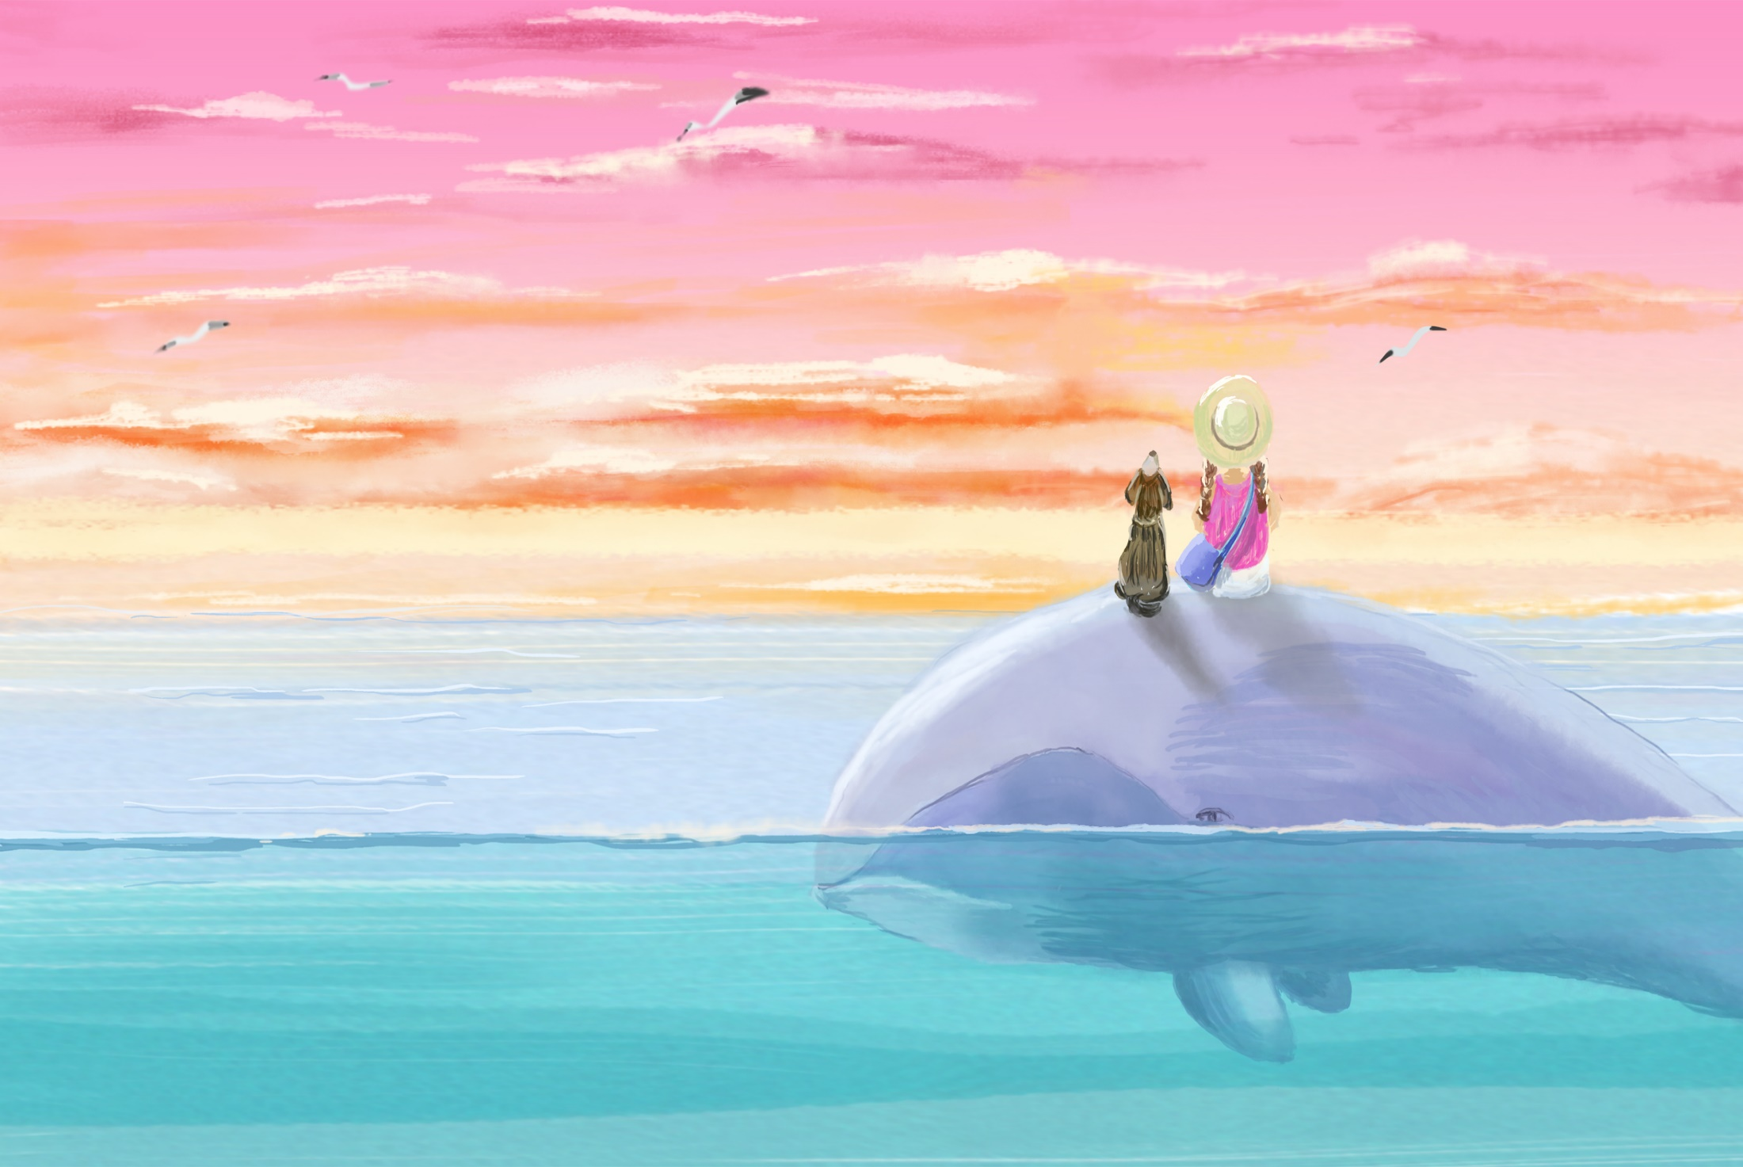
Section A
Reading and Thinking

Slide 3
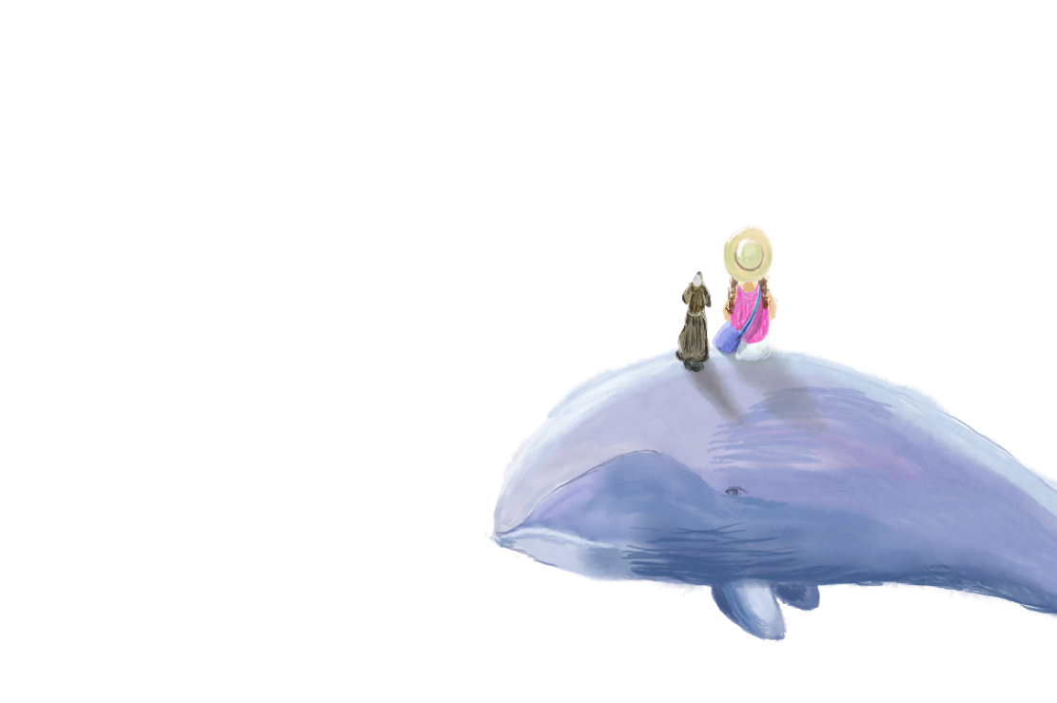
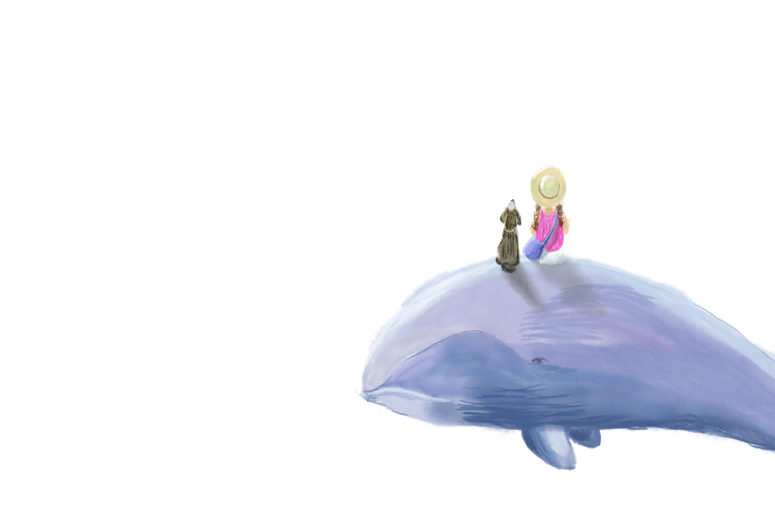

Leading in
Reading
After reading
Discuss questions
Fast reading
Careful reading
I. key words
II. details
III. practice
Conclusion
Brainstorm

Slide 4
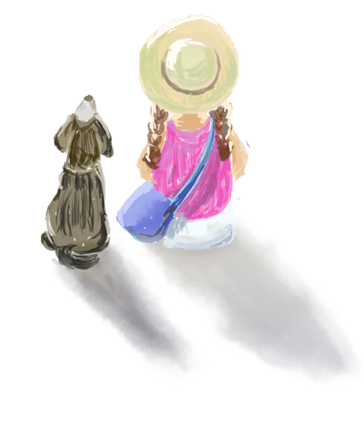
Leading in
Discuss the following questions:
What first-aid techniques do you know of ?
心肺复苏（CPR），人工呼吸（Artificial Respiration），止鼻血（Stop a Bloody Nose），治疗手指切伤（Treat a Cut Finger），治疗扭伤（Treat a Sprain），治疗蚊虫叮咬（Treat Bug Bites），治疗烧伤（Treat a Burn）。

Slide 5

2. If someone you know suffered a burn, what would you do?
First, check to see which degree his or her burn belongs to. If it is just red and mildly swollen, then place the burn under cool water. Dry the burnt area with a clean cloth. Remove any clothes using scissors if necessary.
Cover the burnt area with a loose clean cloth. If the victim is suffering from second or third-degree burns, send him or her to hospital.

Slide 6
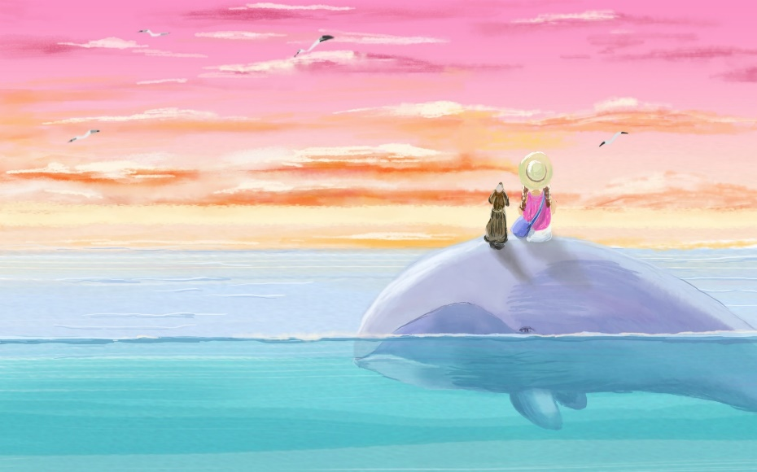
Fast reading
Look through the text and identify its style and language features. Then tick its text type from the list in the Activity 2.
Hospital leaflet

Slide 7
I. Key words & Sentences
Careful reading
technique n.技能，技术，技艺
搭配：marketing techniques(营销技巧)
basic first-aid techniques 基本的急救技能
traditional techniques 传统技能
例：
Fingerprint scanning techniques develop fast.
指纹扫描技术发展迅速。

Slide 8
2. sense of touch 触觉
拓展：
sense of smell 嗅觉
sense of taste 味觉
sense of sight 视觉
sense of hearing 听觉
例：
The blind have a keen sense of touch.
盲人有敏锐的触觉。

Slide 9
3. lead to 导致；造成（后果）
搭配：
lead to the traffic accident 导致这场交通事故
lead to health problems 引起健康问题
lead sb. to…使某人得出某种观点；引导某人到达某地
例：
During this activity, we realized that building up our body is of great important, and we also learned more about “persistence leads to success”.
在这次活动中，我们意识到锻炼身体的重要性，对“坚持才能成功”的道理体会更深了。

Slide 10
4. a variety of 各种各样的
搭配：
a variety of activities 各种各样的活动/理由。
例：
Wander among a variety of shops selling gifts while enjoying a live music show and nice street entertainment.
漫步于各种各样的礼品店，同时欣赏现场音乐表演和精彩的街头娱乐活动。

Slide 11
5. minor adj. 较小的，次要的，轻微的
搭配：
make some minor changes 做一些较小的改动
a minor error 小错误
a minor role 次要角色
例：
There may be some minor changes to the schedule.
时间安排也许会有些小小的变动。

Slide 12
6. urgent adj. 紧急的，急迫的，急切的
搭配：
an urgent matter 紧急的事情
urgent action 紧急行动
in urgent need of… 急需……
例：
He was in urgent need of medical attention.
他急需医疗看护。

Slide 13
as引导非限制性定语从句
as意为“正如，如同”，引导非限制性定语从句，as指代整个主句的内容。
as在从句中可作主语或宾语。
as引导的定语从句可位于主句前面、中间或后面，一般用逗号和主句隔开。
例：
As you know, playing ping-pong can not only build up your body but also shape your character.
正如你所知道的，打乒乓球不仅能锻炼你的身体，还能塑造你的性格。

Slide 14
II. Details
Complete the table to summarise the information about first aid for burns.
Details | Types
 | First-degree burns | Second-degree burns | Third-degree burns
Depth | Affecting only the top few millimetres of the skin | Going below the top layer of the skin | Affecting every layer of the skin and sometimes the tissue underneath

Slide 15
Read the text again and decide if the following statements are true or false.
Your skin gives you protection from many dangerous things.
A first-degree burn has this name because it is the most serious.
Second-degree burns can be the most painful kind of burn.
It is important to use cool water to stop the heat from remaining in the wound regardless of the degree of the burn.
Putting butter or oil on burns helps because it may reduce swelling and ease discomfort.
答案：T F T F F

Slide 16
Conclusion
After reading
Read the text again, and pay attention to the language features. Then discuss the following questions in the group.
What is the genre of this text? Is it a narration, a description, an argumentation, or an expository writing?
(An expository writing.)
What kinds of things are mentioned in the text?
(Functions, causes, different types, characteristics, and procedures.)
Is this text mainly written in first, second or third person?
(In second and third persons.)

Slide 17
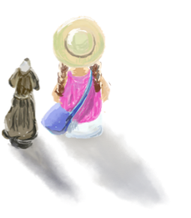

What tense is used?
(The simple present tense.)
Are there any passive voices? How do they make you feel? (Yes. They make the text sound objective.)
What other language features did you find?
(For example, the -ing form.)
What adjectives can you think of to describe this text?
(Objective, scientific, professional, specific, clear, concise, etc.)

Slide 18
Brainstorm
Brainstorm the following questions:
What are the possible occasions when students are likely to get burnt at school?
(When getting hot water after class, we are likely to get burnt.)
What can you do to help prevent getting burnt?
(We should be careful when getting hot water.)
What are the possible occasions when people are likely to get burnt at home?
(When people cook in the kitchen, they are likely to get burnt.)
What can we do to help prevent getting burnt?
(We should be careful when using fire.

Slide 19
