Slide 1
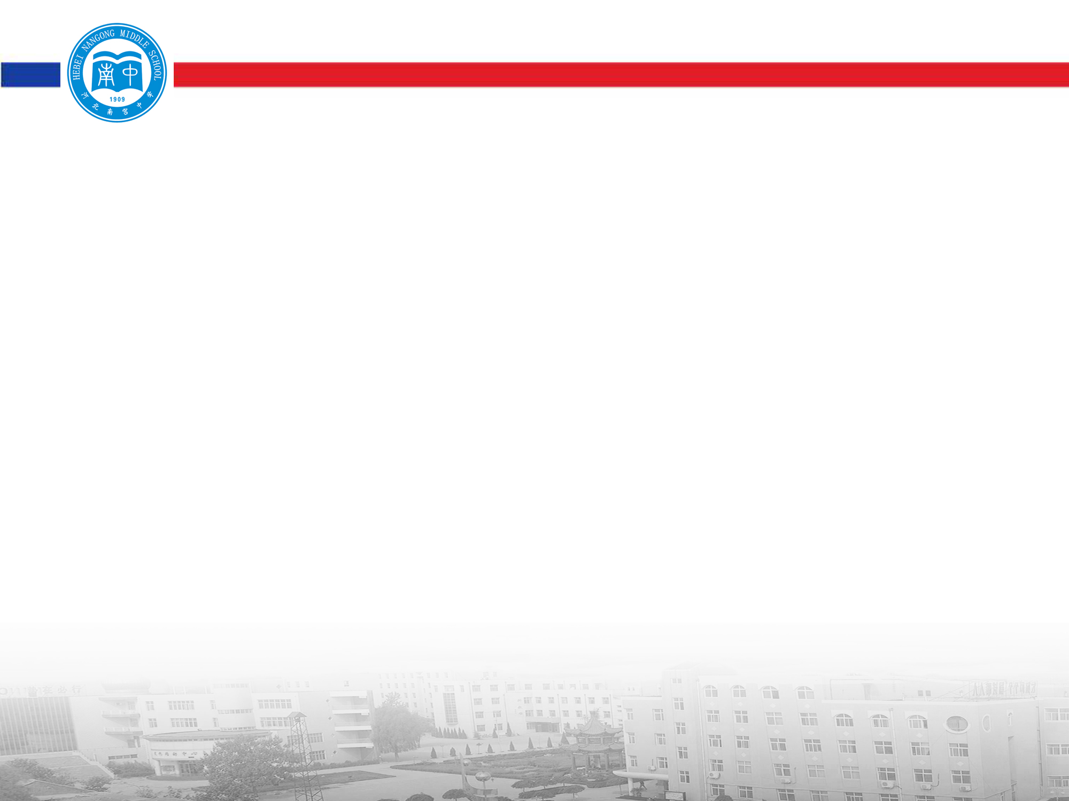
第五节 定语从句

Slide 2
定语从句（Attributive Clauses）在句中做定语，修饰一个名词或代词，被修饰的名词，词组或代词即先行词。定语从句通常出现在先行词之后，由关系词（关系代词或关系副词）引出。

Slide 3
一 、定义及相关术语
1．定语从句：修饰某一名词或代词的从句叫定语从句。定语从句一般紧跟在它所修饰的词之后。
2．先行词：被定语从句修饰的词叫先行词。
3．关系词：引导定语从句的词叫关系词。
关系词有关系代词和关系副词。
关系代词有that, which, who, whom, whose,as等；关系副词有when, where, why等。

Slide 4
提示： 关系词在定语从句中有三大作用
1. 连接作用——连接先行词和定语从句。
2. 替代作用——在定语从句中替代从句所修饰的先行词。
3. 成分作用——在定语从句中作主语、宾语、定语或状语。
The man who is shaking hands with my father is a policeman.
注意：弄清楚关系词在定语从句中充当什么成分，是掌握定语从句、选择好关系词的关键。

Slide 5
二、 关系代词引导的定语从句
引导定语从句的关系代词主要有who, whom, whose, which, that等。它们分别代替前面的先行词，并在定语从句中作主语、宾语或定语。

Slide 6
1. who 指人，在定语从句中作主语
The boys who are playing football are from Class One.
正在踢足球的男孩是一班的。
Yesterday I helped an old man who had lost his way.
昨天我帮助了一位迷路的老人。
That is the teacher who teaches us physics.
那就是教我们物理的老师。

Slide 7
2. whom 指人，在定语从句中做宾语，常可省略，在口语或非正式文体中常可用who 来代替。
Li Ming is just the boy (whom) I want to see.
李明正是我想要见的男孩。
The professor (whom) you are waiting for has come.
你正在等的教授已经来了。
The girl (whom) the teacher often praises is our monitor.
老师经常表扬的那个女孩是我们的班长。

Slide 8
4. that 指人时，相当于who 或whom；指物时，相当于which。在定语从句中作主语或宾语，作宾语时常可省略。
He is the man that/who lives next door.
他就是住在隔壁的那个人。
The person (that/whom) you introduced to me is very kind. 你介绍给我的那个人很友好。
The season that/which comes after spring is summer. 春天之后的季节是夏季。
I don’t like stories that/which have unhappy endings. 我不喜欢结尾悲伤的故事。

Slide 9
5. whose 指人、物皆可，与后面的名词有所属关系，在定语从句中做定语。
I visited a scientist whose name is known all over the country.
我拜访了一个全国知名的科学家。
He has a friend whose father is a doctor.
他有一个爸爸当医生的朋友。
I once lived in the house whose roof has fallen in. 我曾经住在那幢屋顶已经倒塌了的房子里。

Slide 10
注意：指物时，常用以下结构来代替：
The house whose windows are broken is empty.
The house the windows of which are broken is empty.
Do you like the book whose cover is yellow?
Do you like the book the cover of which is yellow?

Slide 11
三、 “介词+关系代词”引导的定语从句
关系代词在从句中作介词宾语时，可以跟介词一起放在从句与主句之间（that, who不可以），也可以把介词放在从句中有关动词的后面，使关系代词紧跟它所修饰的先行词。

Slide 12
The school (which/that) he once studied in is very famous.
= The school in which he once studied is very famous.
他曾经就读过的学校很出名。
Tomorrow I’ll bring here the magazine
(which / that) you asked for.
= Tomorrow I’ll bring here the magazine for which you asked.
明天我将把你要的杂志带来。

Slide 13
This is the boy (whom/who/that) I played tennis with yesterday.
= This is the boy with whom I played tennis yesterday.
这是我昨天跟他打网球的男孩。

Slide 14
注意：
含有介词的短语动词一般不拆开，介词仍放在短语动词的后面。
如：look for, look after, take care of 等。
This is the watch (which/that) I am looking for. (正)
这是我正在找的手表。
This is the watch for which I am looking. (误)

Slide 15
The babies (whom/who/that) the nurse is looking after are very healthy. ( )
那个保姆照看的小宝宝们都很健康。
The babies after whom the nurse is looking are very healthy. （ ）
正
误

Slide 16
2. 介词后的关系代词不可用that和who，若介词放在关系代词前，关系代词指人时只可用whom，指物时只可用which；关系代词是所有格时用whose。
The man with whom you talked just now is my neighbour. (正)
你刚才跟他谈话的那个人是我的邻居。
The man with that/who you talked just now is my neighbour. (误)

Slide 17
The plane in which we flew to Canada was really comfortable. ( )
我们去加拿大所乘坐的飞机实在很舒服。
The plane in that we flew to Canada was really comfortable. ( )
正
误

Slide 18
3. “介词+关系代词”前还可有some, any, none, all, both, neither, many, most, each, few等代词或者数词。
He loves his parents deeply, both of whom are very kind to him.
他深深地爱着他的父母，他们俩待他都很好。
In the basket there are quite many apples, some of which have gone bad.
篮子里有好些苹果，有些已经坏了。

Slide 19
There are forty students in our class in all, most of whom are from big cities.
我们班总共有40个学生，大多数来自大城市。
Up to now, he has written ten stories, three of which are about country life.
迄今为止，他写了10部小说，其中3部是关于农村生活的。

Slide 20
四、关系副词引导的定语从句
引导定语从句的关系副词有when, where和why等。
when, where, why都在定语从句中作状语，在意义上相当于介词+which结构，分别代替表示时间、地点或原因的先行词。

Slide 21
1. when指时间，在定语从句中作时间状语
I still remember the day when I first came to this school.
我仍然记得我第一次来到这所学校的那一天。
The time when we got together finally arrived.
我们团聚的时刻终于到了。
Do you remember the years when he lived in the countryside with his grandparents.
你还记得在农村和你祖父母一起生活的那些年吗？

Slide 22
2. Where 指地点，在定语从句中作地点状语
Shanghai is the city where I was born.
上海是我出生的城市。
The house where I lived ten years ago has been pulled down.
我十年前住的房子已经被拆掉了。
I visited the farm where a lot of cows were raised.
我参观了那个饲养了许多奶牛的农场。

Slide 23
3. why 指原因，在定语从句中作原因状语
Please tell me the reason why you missed the plane. 请告诉我你误机的原因。
The reason why he was punished is unknown to us.
他受惩罚的原因我们都不知道。
I don’t know the reason why he looks unhappy today.
我不知道他今天为什么看上去不愉快。

Slide 24
注意：关系副词引导的定语从句，经常可以用“介词+关系代词”引导的定语从句来表示。
I’ll never forget the day when/on which I first met you.
我永远不会忘记第一次见你的那天。

Slide 25
Great changes are taking place in the city where / in which they live.
他们生活的城市正发生巨大的变化。
The reason why / for which he refused the invitation is quite clear.
他为什么拒绝接受邀请的原因是十 分明了的。

Slide 26
五 、限制性定语从句和
非限制性定语从句

Slide 27
限制性定语从句
形式上：不用逗号“，”与主句隔开。
意义上：是先行词不可缺少的定语，如果去掉，主句则失去意义或意思表达不完整。
译法上：译成先行词的定语“．．．的”
关系词的使用上：A．作宾语时可省略 B．可用that C．可用who 代替whom

Slide 28
非限制性定语从句
形式上：用逗号“，”与主句隔开。
意义上：只是对先行词的补充说明，如果去掉，主句仍能表达完整的意思。
译法上：通常译成主句的并列句。
关系词的使用上：A．不可省略 B．不用that C．不可用who 代替whom

Slide 29
限制性定语从句举例：
The teacher told me that Tom was the only person that I could depend on.
老师告诉我说汤姆是我唯一的可以依靠的人。
China is a country which has a long history. 中国是一个历史悠久的国家。
In the street I saw a man who was from Africa.
在街上我看到一个来自非洲的人。

Slide 30
非限制性定语从句举例：
His mother , who loves him very much, is strict with him.
他妈妈十分地爱他，对他要求很严格。
China , which was founded in 1949, is becoming more and more powerful.
中国是1949年成立的， 现在正变得越来越强大。
I have been to Hangzhou , which is a very beautiful city.
我去过杭州，它是一个非常美丽的城市。

Slide 31
（一）限制性定语从句中只能用that 引导定语从句的情况
注意：
1．当先行词为all, much, little, something, everything, anything, nothing, none, few, the one等词时。
Everything that he said was true.
他所说的一切都是真的。
Is there anything that I can do for you?
有我能为你效劳的事吗？
That’s all that I know. 我知道的就这么多。

Slide 32
2.当先行词被the very（恰恰，正好）, the only，any，few，little，no，all修饰时。
This is the very grammar book (that) I want to buy. 这正是我要买的语法书。
The only thing that is constant is change.
唯一不变的是变化。
There was little that we could do to help her.
我们没有什么能帮助她的。

Slide 33
3．当先行词是形容词最高级或被形容词最高级修饰时。
This is the best that has been used against pollution.
这是曾经用过的最好的抗污染的办法。
This is the most interesting film that I've ever seen.
这是我看过的最有趣的电影。

Slide 34
4. 当先行词是序数词或被序数词修饰时
The first place that they visited in London was the Big Ben.
在伦敦他们参观的第一个地方是大本钟。
What is the first American film that you have seen?
你看过的第一部美国电影是什么？

Slide 35
5．当主句的主语是疑问词who或which时
Who that has common sense will believe such nonsense?
有常识的人谁会相信这种无聊的事情？
Which is the T-shirt that fits me most?
哪件T恤衫最合我的身？

Slide 36
6．当先行词既有人又有物时
Do you know the things and persons that they are talking about?
你知道他们谈论的人和事吗？

Slide 37
7．先行词在主句中做表语,而关系代词在从句中也做表语时
She is no longer the sweet girl (that) she used to be.
她再也不是过去那个甜美的女孩了。
He is not the man (that) he seems.
他这人不可貌相。

Slide 38
（二）关系代词as和which 引导的定语从句
as 和which 引导非限制性定语从句时， 其用法有相同之处，也有不同之处。具体情况是：
1. as 和which都可以在定语从句中做主语或宾语，代表前面整个句子。如：
He married her, as / which was natural.
他跟她结婚了，这是很自然的事。
He is honest, as / which we can see.
他很诚实， 这一点我们看得出来。

Slide 39
2. as 引导的非限制性定语从句可以放在主句之前、主句之后，甚至还可以分割主句。 which 引导的非限制性定语从句只可放在主句之后。
另外，as 常常有“正如、正像”的含义。如：
As is known to all, China is a developing country.
众所周知，中国是发展中国家。

Slide 40
He is from the south, as we can know from his accent.
他是南方人，这一点我们从他的口音可以知道。
John, as you know, is a famous writer.
正如你所知， 约翰是个著名作家。
Zhang Hua has been to Paris more than ten times, which I don’t believe.
张华已去过巴黎十多次了，这一点我不相信。

Slide 41
(三) 以the way为先行词的限制性定语从句通常由in which或that引导，而且通常可以省略。如：
The way (that/in which) he answered the questions was surprising.
他回答这些问题的方式令人惊奇。
I don’t like the way (that/in which) you laugh at her.
我不喜欢你嘲笑她的样子。

Slide 43
定语从句精选练习
1.(1) This is the hotel_______ we will stay at.
(2) This is the hotel_______ we will stay.
(3) This is the hotel__________ we will stay.
(4) This is the hotel ________we will visit.
(5) This hotel is the one _______ we will stay at.
(6) This hotel is the one _________ we will stay.
(7) This hotel is the one __________ we will visit.
(8) This hotel is___________ we will stay.
(9) This hotel is___________ we will visit.

Slide 44
2. (1)I'll never forget the days ___________we spent in the countryside.
(2)I'll never forget the days ___________we lived in the countryside.
(3)I'll never forget the days_______ we spent together.
(4)I'll never forget the days ______ we worked together.
A. that B. when C. whose D. whom

Slide 45
3. a) Is this flat __________ you once lived in
b) Is this the only flat __________ you have lived in ?
c) Is this the flat __________ you once lived ?
d) Is this the flat in __________ you once lived ?
e) Is it in this flat __________ you once lived ?
A. which B. where
C. that D. the one

Slide 46
4. (1) He still lives in the room _____ window faces to the east.
(2) He still lives in the room, the window _____ faces to the east.
(3) He still lives in the room _____ is in the north of the city.
(4) He still lives in the room _____ there is a beautiful table.
A. which B. whose
C. where D. of which

Slide 47
5. (1)He was ill, ______ he was absent from school.
(2)He was ill, ______ reason he was absent from school.
(3)He was ill, and ______ reason he was absent from school.
(4)He was ill. That’s ______ he was absent from school.

Slide 48
(5)He was absent from school. That’s ____ he was ill.
(6)I don’t believe the reason ____ he was absent from school.
(7)I don’t believe the reason ______ he explained for his absence from school.
A. which B. for which C. for that
D. because of which E. because F. why

Slide 49
I. 单句改错:
1. Do you know the boy his father is a doctor?
2. He lives in a house which windows face south.
3. A plane is a machine can fly.
4. I will never forget the day which I joined the Communist Party.
5. The factory which my father works is in the east of the city.

Slide 50
6. None of us know the reason which he was absent from the meeting.
7. You should hand in all which you have.
8. This is the very book which I am looking for.
9. The girl who often help me with my English is Li Ming’s sister.

Slide 51
10. This was the book you are looking for.
11. The man visited our school yesterday is a professor.
12. The hospital my mother works was built last year.
13. Is this factory which you set up yourselves?

Slide 52
II. 用恰当的关系词填空。
1. Please pass me the book ________ cover is green.
2. Is he the man ______ wants to see you?
3. A prosperity ______ had never been seen before appears in the countryside.
4. There are occasions _______ one must yield.
5. Is this the reason ________ he refused our offer?

Slide 53
6. I know the reason _____ he explained at the meeting.
7. His father died the year _______ he was born.
8. The man ______ visited our school yesterday is a professor.
9. The hospital_______ my mother works was built last year.
10. Is this the factory ________ you set up yourselves?

Slide 54
Thank you!

