Slide 1
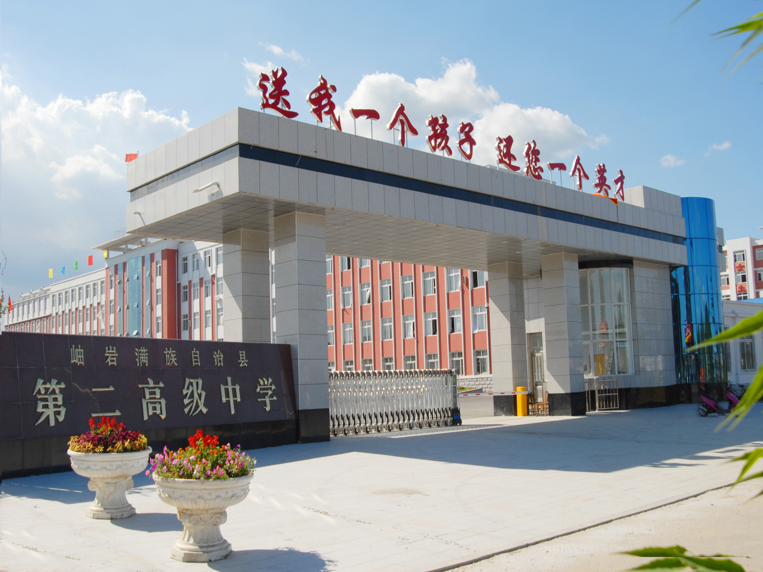
英语组
付利

Slide 2
完形填空解题技巧

Slide 3

完型填空试题主要特点：
1. 通常从一篇300-350词左右，文章中设空20个，首句不挖空；
2. 干扰项设计严密.一般情况下，四个选项的词性相同或属于同等或对等范畴，干扰项填入后在语法上一般不存在错误，对考生有很大的迷惑作用；
3.突出语篇(语境)，强调应用，注重交际；
4.大多富有积极的教育意义，给人以人生的启迪或是充满了生活情趣；

Slide 4
历年高考英语完形填空题型考情分析：
试卷 | 年份 | 体裁 | 考察类型
 |  |  | 动词 （短语） | 名词 （短语） | 形容词 （短语） | 副词 | 介词 （短语） | 连词 | 代词
全国卷 I | 2018 | 夹叙夹议 | 9 | 7 | 3 | 1 | 0 | 0 | 0
 | 2017 | 夹叙夹议 | 10 | 5 | 4 | 1 | 0 | 0 | 0
 | 2016 | 记叙文 | 7 | 4 | 3 | 1 | 1 | 3 | 1
全国卷 II | 2018 | 记叙文 | 10 | 3 | 4 | 2 | 1 | 0 | 0
 | 2017 | 记叙文 | 9 | 8 | 3 | 0 | 0 | 0 | 0
 | 2016 | 夹叙夹议 | 6 | 4 | 5 | 2 | 2 | 0 | 0
全国卷 III | 2018 | 记叙文 | 10 | 6 | 4 | 0 | 0 | 0 | 0
 | 2017 | 记叙文 | 9 | 7 | 4 | 0 | 0 | 0 | 0
 | 2016 | 记叙文 | 7 | 6 | 4 | 0 | 0 | 1 | 1

Slide 5
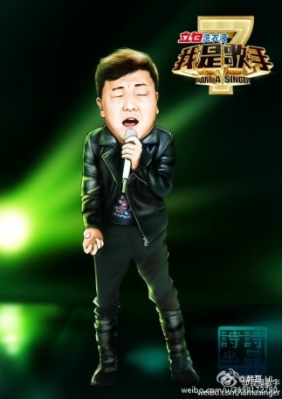
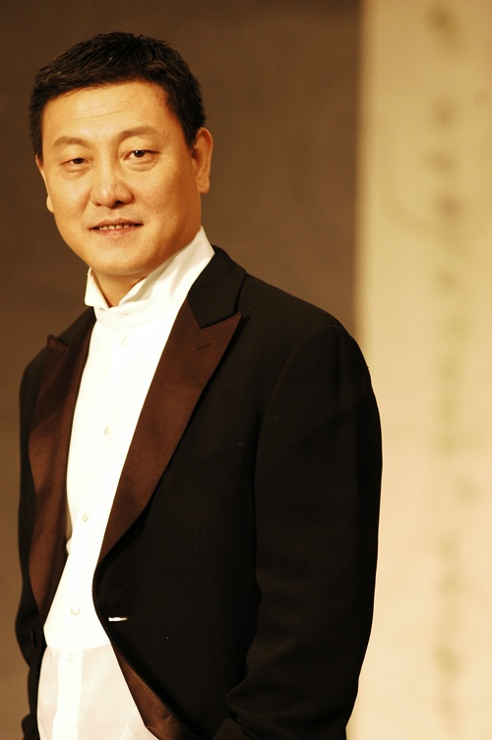

Slide 6

现在我想谈谈韩磊。韩磊从前在我的印象中就是一个_1__的歌手的存在。每次一想到韩磊，我脑子里都会自动蹦出“曝光率低”“属于上个世纪的歌手” “没什么粉丝”一类的词。但是《我是歌手》这个节目让我__2__了对他的这一印象。在这个舞台上，韩磊变得更有活力，更富激情，更擅于突破，更__3_。最终他成为了___4__的总冠军。在这个充满激烈竞争的比赛中，韩磊用实力证明了什么叫做__5____
A. 超级出名 B. 过了气了 C. 英俊潇洒 D. 实力不凡
A. 延续 B. 坚定 C. 改变 D. 深化
A. 墨守成规 B. 迂腐守旧 C. 深沉内敛 D. 大胆创新
A. 我是歌手 B. 中国好歌曲 C. 非诚勿扰 D.天天向上
A. 己所不欲，勿施于人 B . 出来混迟早是要还的
C. 不怕神一样的对手，就怕猪一样的队友 D. 真金不怕火炼

Slide 7
既然……
那么……

Slide 8

技巧点拨
1. 注意上下文语境（context)
信息复现、逻辑关系
2. 掌握习惯搭配（phrases & idioms）
运用词义辨析 （comparison）
3. 了解常识背景（common sense）
4. 运用语法分析（grammar analysis)

Slide 9

1）上下文语境
例1:He’d moved to England with his mum when he was three and it had been 13 years since I’d last seen him. So imagine my __1__when he emailed me saying he wanted to come to visit me .(2018 II)
A. delight B. relief C. anger D. worry

Slide 10
2）句际间的逻辑推理关系
例1： It has been many years since I was last in London, ______ I still remember something that happened during that visit.
A. and B. for C. but D. as
___________
_____________
例2： A transistor radio is sometimes very small. It is very easy to carry… 48 , radio broadcasts are better for blind people.（2015安徽）
48. A. Besides B. However
C. Yet D. Sometimes
___
___

Slide 11
例3… and the officers then began to eat their meal , saying that the mushrooms had a very strange 38 quite pleasant taste.(2016浙江)
38. A. besides B. but C. and D. or
例4： They are some of the poorest people in a poverty -stricken country. 53 , now they have an extra source of income . 2015
53. A. But B. And
C. However D. Therefore

Slide 12

3)词汇的复现
例2：The problem is that countries around the world have growing mountains of _2___ because people are throwing out more rubbish than ever before.
2. A. gift B. rubbish C. debt D. Products

Slide 13

4)词语固定搭配及辨析
例2:I think the faith that everyone has show ___ him has touched him . People have been approaching him in the street , he has had job ___ and all sorts .（2018 北京卷）
18. A of B at C for D in
19 A details B changes
C offers D applications
show faith in sb 对…. 表示信任
eg . I have great faith in you .

Slide 14

5)生活常识及文化背景知识
例1： …,she was always waiting at the bus stop around 8:00. On 39 days, she wore heavy clothes and a pair of woolen gloves.
39. A.sunny B.rainy
C.cloudy D.snowy

Slide 15

例2： Immediately the officers jumped into their cars and rushed to the＿＿＿hospital.
A. animal B. biggest
C. plant D. nearest

Slide 16

三、实战演练
做题三忌：
急于求成，未通读全文便忙于答题，不了解文意，无整体概念边读边填，两眼忙于空白与选项之间，欲速则不达。
只抠字眼，语法，不顾文意，抓不住关键。
断章取义，就题论题，不管前后联系，互不照应，前后矛盾。

Slide 17
一、英语完形填空解题思路
跳过空格，通读全文， 把握大意
结合选项，综合考虑，初定答案
再读全文，仔细检查

Slide 18
36---40 DACBA
41---45 DCCDB
46---50 ACBAD
51---55 DDCBA

Slide 19
Once upon a time the colors of the world started to quarrel. Green said, "Clearly I am the most important. I am the sign of life and hope. I was chosen for grass, trees and leaves. Without me, all animals would 36 ."
Blue interrupted, "You only think about the 37 , but consider the sky and the sea. 38 the water that is the basis of life and drawn up by the clouds from the deep sea．Without my peace, you would all be 39 ."
Yellow chuckled （笑道）, "You are all so serious. I bring laughter, fun, and __40__ into the world．"
36.A.stay B.leave
C.go out D.die
37. A.earth
B.moon
C.star D.sun
38．A.That is
B.I am
C.It is
D.This is
39．A.anything
B.nothing
C.something
D.Everything
40．A.warmth
B.sadness
C.depression
D.anxiety
-词义
强调句
转折.对比.排除
词义
同类并列

Slide 20
Orange started next to blow her trumpet, "I am the color of health and strength. I may be 41 , but I am precious for I serve the needs of human life. When I fill the sky 42 , my beauty is so striking that no one gives another 43 to any of you.”
Red could stand it 44 and he shouted out, "I am the ruler of all of you. I am the color of danger and of bravery. I am willing to 45 truth. I am also the color of passion and of love."
41.A.usual
B.normal
C.common
D.scarce
42．A.at midnight
B.at noon or at night
C.at sunrise or sunset
D.during the day
43．A.gift B.honor
C.thought D.respect
44．A.for more
B.any more
C.very much
D.no longer
45．A.turn to
B.fight for
C.struggle with
D.bend over
转折对比
常识
gives another
43 to
搭配
could stand it 44
搭配
词义

Slide 21
Then came Purple and Indigo （深蓝）. …
The colors went on boasting, each convinced of his or her own __46__. Their quarreling became louder and louder. Suddenly there was a startling flash of bright lightening thunder. Rain started to pour down __47__. The colors crouched(蜷缩) down __48__, drawing close to one another
for comfort.
In the midst of the clamor （叫嚷）, rain began to speak, “You foolish colors, fighting 49 yourselves, each trying to dominate（支配） 50 .
46．A.superiority B.disadvantages
C. reputation
D.weakness
47.A.gently B.quietly
C.violently
D.peacefully
48．A.with care
B.in fear
C.by chance
D.on purpose
49．A.among
B.by C.for
D.against
50．A.others
B.themselves
C.the other
D.the rest
近义词再现
词义.常识
词义
词义辨析
搭配

Slide 22
近义词再现
51．A.equal and simple
B.ordinary and similar
C.more or less
D.unique and different
52. A.each other
B.me C. them
D. one another
53．A.combined
B.separated
C.united D.divided
54．A.cleans B. washes
C.brightens
D.dampens
55．A.appreciate
B.quarrel with
C.ignore D.praise
Don't you know that you were each made for a special purpose, 51 ? Join hands with 52 and come to me."
Doing as they were told, the colors 53 and joined hands. They formed a colorful rainbow. From then on, whenever a good rain
54 the world, a rainbow appears in the sky. They remember to 55 one another.
Join hands
with 52
搭配
近义词再现
常识
词义

Slide 23
为什么我们在这一题型上总是失分较多?
    没有严格遵循答题步骤:很多考生一拿到完形填空题就急于选择答案，不认真分析通篇文章，单纯求快，忽略语篇理解，只看局部的词义辨析、搭配和语法结构。表面上解题速度挺快，但是这种见树不见林的做法只会影响解题的质量和效率。
切记:一定要用2-3分钟时间先进行缺词阅读,弄清文章大意和基本脉络后再着手逐个填空.

Slide 24
3.时间安排不当:在几个选项上过分纠缠，追求完美，导致许多本可以做出的题来不及做。
切记:正确的做法是由易到难，先做会做
的，再考虑较难的。
强烈推荐：如尚有几题题目不确定可将某题的可能的两项填入空格, 然后快速地整句整段地默读, 选择某一项习惯或短语或动宾搭配读起来较流畅的.

Slide 25

课堂小结
完形填空的解题技巧
1）根据上下文语境解题
2）根据句段间的逻辑推理关系解题
3) 根据词汇的复现解题
4）根据词语固定搭配及辨析解题
5）根据生活常识及文化背景解题

Slide 26
Can we make the methods easier?
Just do it!
干

Slide 27
Practice makes perfect!

Slide 28
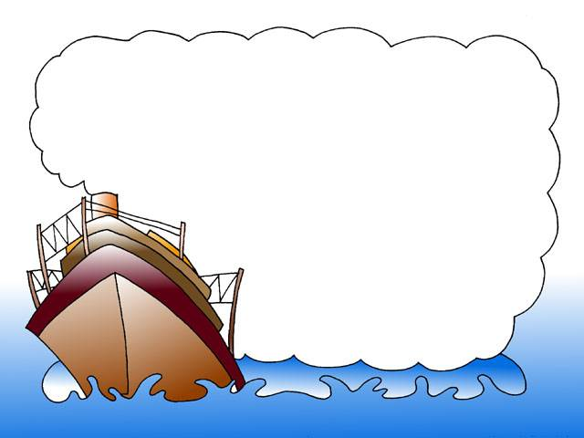
Practice time!

Slide 29
16---20 CBDDB
21---25 AACBA
26---30 CBDAB
31---35 CBDAD

Slide 30
Homework
Finish the cloze test in your workbook P.117(B)

Slide 31

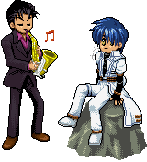
Thank you !
thank you

