Slide 1






高考英语语法填空答题技巧

Slide 2
题型分析
语法填空
学情分析
教学目标
教学重难点
教学步骤

Slide 3
Analysis of teaching material (题型分析)
1、选材：200词左右，话题贴近学生生活
2、命题形式：纯空格形式(3-4个)，有提示词
(6-7个)。要求考生在理解上下文的基础上，
根据单词提示写出正确形式。
3、考查内容：篇章中综合运用语法知识的能力
4、考点设置：词法、句法和逻辑关系方面的知识。
5、分值：题目共10小题，满分15分
6、建议用时：8-10分钟

Slide 4
Teaching goals(教学目标)
1、知识目标：使学生熟悉语法填空的命题特点、解题思路及技巧。
2、能力目标：通过真题分析、演练，使学生把握有无提示题型的考点分布。在讲练结合的基础上，引导学生分析考点，总结解题技巧，达到学以致用的目的。同时引导学生关注文章微观语境中词汇、句子与篇章结构的联系
3、情感目标：通过对真题的探析，使学生对高考语法填空这一题型树立信心，从容应对。

Slide 5
Teaching important points（教学重点）
熟练掌握语法填空的有提示词与
无提示词的考点及解题思路
Teaching difficult points（教学难点）
运用归纳的考点完成语法填空

Slide 6

Faced with so many grammar rules,
what should we do?
解题四步走
检查搭配, 前后连贯
根据语义, 确定词形
分析句子,确定词性
通读全文,理解大意

Slide 7
Exercises and Summary
1.有提示词
Individual work
主要考察动词，名词，形容词和副词，人称代词的用法

Slide 8
自主感悟：有提示词：动词
1. When fat and salt ___________ (remove) from food, the food tastes as if is missing something.
2. It was raining when I _______(arrive) in Yangshuo just before dawn.
3. He walked in as if he___________(buy) the school.
are removed
arrived
had bought
动词做谓语

Slide 9
有提示词（动词）
找动词，找连词
(1)He got interested in two theories _____ (explain) how cholera killed people.
explaining
(2) I joined in a race ______ (host) by the city sports club.
hosted
(3)It took years of work__________(reduce ) the industrial pollution and clean the water.
无动词，加动词
有动有连，再加动词
有动无连，再加非谓语
动词做非谓语

Slide 10
抢分必备：给出了动词的提示
首先要确定是 还是 。
若句中缺谓语动词，所给的动词就是谓语动词（ , ， ， ）。
若句中不缺谓语动词，所给的动词就是非谓语动词（V-ing, V-ed, V-to do）：
V-ing表主动，进行或介词之后
V-ed表被动，完成
V-to do表主动，将来，目的状语，结果状语，形容词后的状语
有时也要根据句式搭配来确定,如see/hear/ notice sb. do/doing sth. ,spend...doing sth.等。
谓语动词
非谓语动词
时态
语态
语气
主谓一致

Slide 11
有提示词（名词）
（1）名词数和格变化
（2）名词词性的变换
1. Today there are about fifteen hundred __________（lifestyle） in the world.
2…for most of us，the _______(achievement) are gradual and require a lot of effort and work, …
3. Just be ________ (patience) .
4. The group followved a _______ (tradtion) course.
lifestyles
achievements
patient
tradtional

Slide 12
自主感悟：
1.There are ten (woman) teachers and two hundred boy students in the school.
2. Keep the (photo) secret and don’t let them out to the media.
3. English is my (strong).
women
photos
strength
名词抢分必备：主要考查名词的复数形式或该名词的其他形式

Slide 13
有提示词（形容词）
（1）比较级和最高级使用。
（2）形、副转换。
（3）形容词变成名词形式。
The river was so polluted that it ______ (actual) caught fire and burned.
That hard work paid off and now he is ________ (good) than before.
actually
better
4. He must be ________ (bad) hurt.
badly
taller
5. Nobody could be __________ (tall).
6. It brings so much _________(kind) and happiness to their hearts.
kindness

Slide 14
2.无提示词
主要考查冠词、介词、代词、连词、it做形式主语或形式宾语、三大从句连词以及从上下文语境的角度设题等方面

Slide 15
自主领悟：
冠词抢分必备：主要考查冠词的泛指、特指以及固定短语中的冠词
a
1. As____result, people ll eat more food to try to make up for that something missing.）
2. The adobe dwellings(土坯房)built by the Pueblo Indians of the American Southwest are admired by even ___________most modern of architects and engineers.
3. he owned_____farm,which looked alomost abandoned.
the
a

Slide 16
自主感悟：
1. But my connection with pandas goes back ____my days on the TV show.
2.For those who fly to Guilin, it’s only an hour away _______ car and offers all the scenery
of the better-known city.
3. _____ the same time, they warm up again for the night.
to
by
At
介词抢分必备：固定搭配；介词的用法

Slide 17
自主领悟：
1. The railway quickly proved to be a great success andmore than 25,000 people were using_____ every day.
2. She though I had hurt ________(I)
3. Now it occurred to _______ that his farm had much potential.
it
myself
him
代词抢分必备：主要考查人称代词的主格、宾格、形容词性物主代词 、名词性物主代词以及反身代词的相互转换。语法填空对人称代词的考查，有时给出提示词，有时则不给提示词。

Slide 18
自主感悟：
1. In much of Asia,especially the so-called“rice bowl”cultures of China,Japan,Korea,____Vietnam.
2. Confucius, ______lived from roughly 551 to 479 B.C., influenced the development of chopsticks.
3.When harvest came around, he was already selling herbs, vegetables and cotton in the market _______ people from the towns met regularly.
and
who
where

Slide 19
连词抢分必备：
①若空格前后是两个结构完整句子，那么空格处大部分是填并列连词：and,but,or,so； 或者从属连词 if,although/though,while,when,since,unless,
because,before…
②主要考查定语从句，状语从句和名词性从句中连词的基本用法

Slide 20
1.Some of my friends who had been there before said ______was a wonderful holiday destination.
2. Jane was walking round the department store. She remembered how difficult _____ was to choose a suitable Christmas present for her father.
it
it
主要考查it作形式主语或形式宾语的常见句型及其句型特点

Slide 21
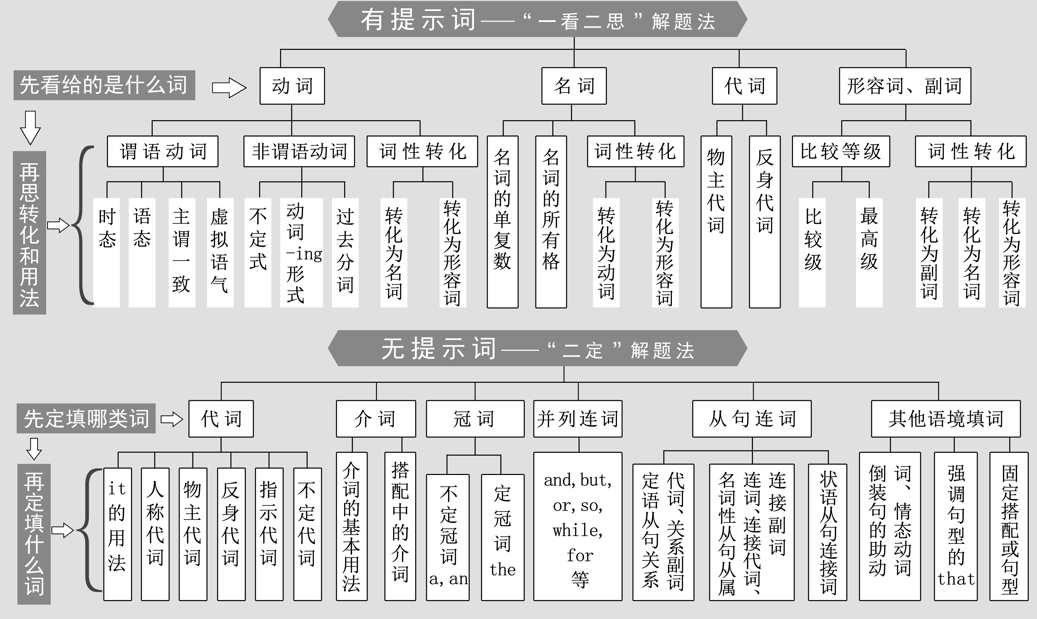
What have we learnt in this class?

Slide 22
Consolidation 篇章练习
She looks like any other schoolgirl, fresh-faced and full of life. SarahThomas is forward to challenge of her new A-level course. But unlike school friends, 16-year-old Sarah is not spending half-term 61. resting (rest). Instead, she is earning $6500 a day as 62. a model in New York.Sarah 63.was told (tell) that she could be Britain’s new supermodel, earning a million dollars in the new year. Her father Peter, 44, wants her to give up school to model full-time But Sarah, 64. who has taken part in shows along with top models, wants 65. to prove (prove) that she has brain as well as beauty. She is determined to carry on with her 66. education (educate).
She has turned down several 67. invitations (invitation) to star at shows in order to concentrate on her studies After school she plans to take a year off to model full time before going to university to get a degree 68. in engineering or architecture. Sarah says, “My dad thinks I should take the offer now. But at the moment, school 69. comes (come) first. I don’t want to get too absorbed modeling. It is70. certainly (certain) fun but the lifestyle is a little unreal. I don’t want to have nothing else to fall back on when I can’t model my more.”

Slide 23

Step4: 小组合作
学生分组根据一篇短文设计语法填空
要求：
1.谓语动词 2个 2.非谓语动词 2个
3.名词 单复数 1个 4.词性转换 2个
5.引导词 1个 6.介词 1个
7.冠词 1个
When sharing your creative blanks, please tell us:
1. Why you set this blank?
2. Which skill is needed?
3. What kind of mistake students may make?

Slide 24
Do you like travelling? Staying healthy while travelling can help to ensure your trip is a happy and enjoyable one.
When you are travelling abroad, here are the tips you need to make your trip much easier. Make sure you have got signed passport and visas. Also, before you go, fill in the emergency information page of your passport! Make two copies of your passport identification page. This will help a lot if your passport is stolen. Leave one copy at home with friends or relatives. Carry the other with you in a separate place from your passport. Read the Public Announcements or Travel Warnings for the countries you plan to visit. Get yourself familiar with local laws and customs of the countries to which you are travelling. Leave a copy of your itinerary(旅行日程) with family or friends at home so that you can be contacted in case of an emergency. Do not accept packages from strangers. Do not carry too much money or unnecessary credit cards. If we make enough preparations, we will succeed. Have a good time!

Slide 25
学生分组展示他们的设计的题目
并解释考点
present your work
please tell us:
1. Why do you set this blank?
2. Which skill is needed?
3. What kind of mistake students may make?

Slide 26
Sample
Do you like travelling? Staying 1_________ (health) while 2_________ (travel) can help to ensure your trip is a happy and enjoyable one. 3 ________ you are travelling abroad, here are the tips you need to make your trip much 4_________(easy). Make sure you have got signed passport and visas. Also, before you go, fill in the emergency information page of your passport! Make two copies of your passport identification page. This will help a lot if your passport 5_________ (steal). Leave one copy at home with friends or relatives. Carry the other 6________ you in a separate place from your passport. Read the Public Announcements or Travel Warnings for the countries you plan to visit. Get yourself familiar with local laws and customs of the countries to 7_________ you are travelling. Leave a copy of your itinerary(旅行日程) with family or friends at home so that you can be contacted in case of an emergency.Do not accept packages from strangers. Do not carry too much money or 8_________(necessary) credit cards. If we make enough 9_________(prepare), we will succeed. Have 10_________good time!

Slide 27
设计意图：
本环节使自主学习和合作学习相结合，任务的设置层层递进，由简到难，逐步突破难点。旨在培养学生学以致用，大胆创新，逆向思维的能力，把本节课学习的重点内容全部融入到任务中，使学生在完成任务的同时全面复习巩固本课重点知识，以便提高学生分析问题、解决问题的能力。

Slide 28
Thank you for listening! Any suggestions are welcome!

