Slide 1

Underline the clause:
Don’t forget the things that once you owned. Treasure the things that you can’t get. Don't give up the things that belong to you and keep those lost things in memory.
曾经拥有的，不要忘记。不能得到的，
更要珍惜。属于自己的，不要放弃。
已经失去的，留作回忆。

Slide 2

Unit 2
Grammar
The Attributive Clause

Slide 3

What is the attributive clause? (什么是定语从句）

Slide 4
Join the following sentences:
A plane is a machine. The machine can fly.

Slide 5
Join the following sentences:
A plane is a machine. The machine can fly.
A plane is can fly.
a machine
the machine

Slide 6
Join the following sentences:
A plane is a machine. The machine can fly.
A plane is can fly.
a machine
the machine

Slide 7
Join the following sentences:
A plane is a machine. The machine can fly.
A plane is can fly.
a machine
that /which

Slide 8
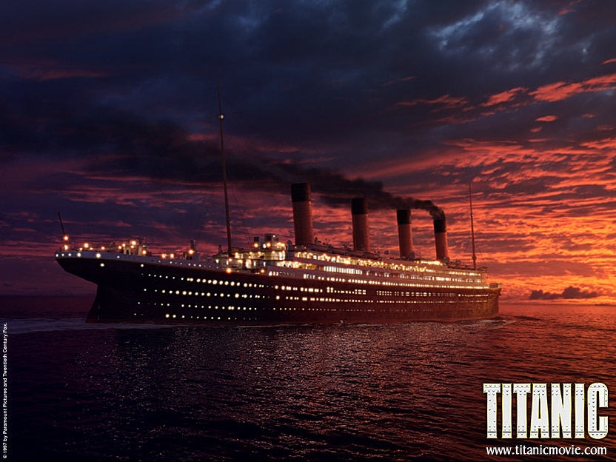
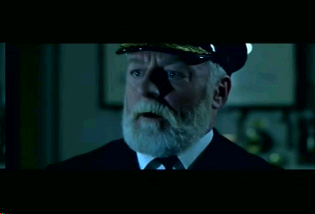
Titanic is a film.
People like the film a lot.
Titanic is a film (that/which ) people like a lot.

Slide 9
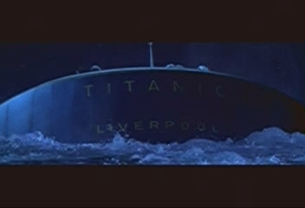
Titanic is also a ship.
The ship sank after hitting an iceberg.
Titanic is also a ship which/that sank after hitting an iceberg.

Slide 10
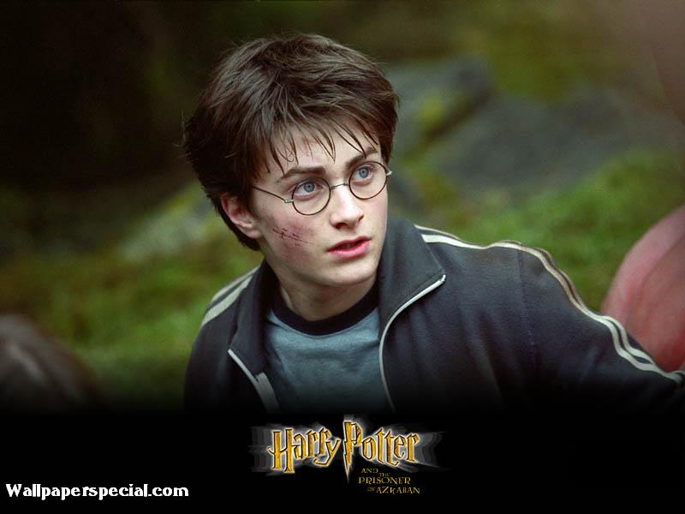

Which one is Harry Porter ?
The boy is Harry Porter

Slide 11
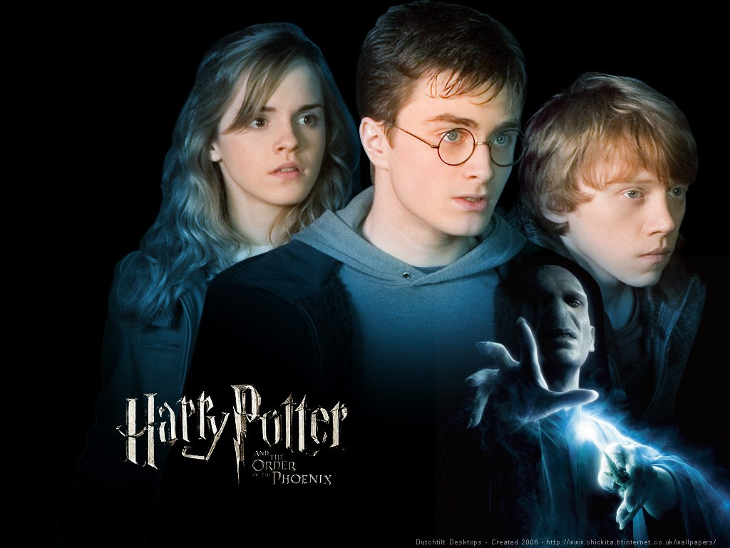
Which one is Harry Porter ?
定语从句
who is wearing glasses
The boy _______________________ is Harry Porter .

Slide 12
The definition of Attributive Clause
定语从句：是指在复合句中，
修饰 或 的从句.
被定语从句所修饰的名词或代
词叫做“ ”.
引导定语从句的词叫“ ”
名词
代词
先行词
关系词

Slide 13
定语从句的要素：
从句，先行词，引导词（关系代词和关系副词）
The lady is Rose.
The lady
who is very beautiful
who
从句
引导词(关系代词或关系副词)：引导定语从句的词
引导词的作用:
1)把两个句子连起来构成一个复合句;
2）代替先行词的意思；
3）在从句中充当一定的成分(作主语、宾语、定语等).
先行词：
被定语从句所修饰的词
（先行词一般是名词或代词）

Slide 14
引导定语从句的关系词
关系代词
指代人
指代事物
所属关系
指地点
指时间
指原因
who，whom，that
which，that
whose，of which
where
when
why
关系副词

Slide 15

定语从句考点归纳
1.that 与which
2as 的使用
3whose 的使用
4 如何判断介词
5 when, where, why 与that, which 的区分
6 定语从句中的动词的数

Slide 16
1）Titanic is a film (which/that) people like a lot.
2) Titanic is also a ship which/that sank after hitting the iceberg.
3) The lady who/that is very beautiful is Rose .
4) The man ( who/whom/that) Rose wanted to marry is Jack .
5）Cal is a young gentleman whose father is a millionaire.
6) Titanic is a film whose story is very moving.

Slide 17
1）Titanic is a film (which/that) people like a lot.
2) Titanic is also a ship which/that sank after hitting the iceberg.
3) The lady who/that is very beautiful is Rose .
4) The man ( who/whom/that) Rose wanted to marry is Jack.
5）Cal is a young gentleman whose father is a millionaire.
which/that指物，在从句中可作主语和宾语；
who/whom/that指人,who/that在从句中可作主语和宾语；whom只作宾语；
6) Titanic is a film whose story is very moving.
whose 指人或指物,在从句中作定语

Slide 18
本节课应掌握的引导词有关系代词who，whom，that，which，whose.其用法是：
which/that指物，在从句中可作主语和宾语；
who/that指人,在从句中可作主语和宾语；
whom 指人,在从句中作宾语；
(即that既可指人又可指物)
whose 指人或指物,在从句中作定语
注意
关系代词which，that，who，whom在从句中作宾语时可省略。

Slide 19


能力提高

Slide 20

1.that 与which
that
1.Nothing ______ can be done has been done.
2.Do you have anything ______ you don’t understand ?
that
先行词是everything, nothing, anything, something, much, little, none等不定代词，引导定语从句用that

Slide 21
1.that 与which
1.This is the best TV _______ is made in China.
2.The first museum _______ he visited in China was the History Museum.
that
that
先行词被形容词最高级或序数词修饰时，引导定语从句用that 。

Slide 22
1.that 与which
that
I’ve read all the books ________
you lent me.
先行词被any, some, no, much, few, little, every, all, very, only, last 修饰时,引导定语从句用that 。

Slide 23

1.that 与which
1.The famous writer and his works _____ the radio broadcast have aroused great interest among the students.
2.A victim is a person, animal or thing ______ suffers pain, death, harm, etc.
that
that
先行词中既有人又有事物时，
引导定语从句用that .

Slide 24
1.that 与which
1.Who _______ you have ever seen can do it better ?
that
Who做先行词时，引导定语从句用that

Slide 25
1.that 与which
1.Her bag ,in ________ she put all her money, has been stolen.
2.This is the ring on ________ she spent 1000 dollars.
3.Xiao Wang ,with ________ I went to the concert, enjoy it very much.
which
which
whom
在介词后面，指事物用which，指人用whom

Slide 26
3 Whose 的使用
whose 引导的定语从句
表示所属关系
The river _________ banks are covered with trees flows to the sea.
whose

Slide 27
4 as 的使用
as
The earth is round,___ we all know.
___ is known to all, the earth is round
___ is known to all that the earth is round.
As
It
定语从句在句首时只能用as, as 具有正如之意，与之搭配的动词一般是固定的

Slide 28
as 的使用
This is such an interesting book ____ we all like.
This is so interesting a book _____ we all like.
as
as
定语从句
这是大家都喜欢的如此有趣的一本书。

Slide 29
定语从句三步：
第一找出先行词
第二看先行词在定语从句中的
语法功能（做主语、宾语或状
语）
第三选择合适的关系词

Slide 30
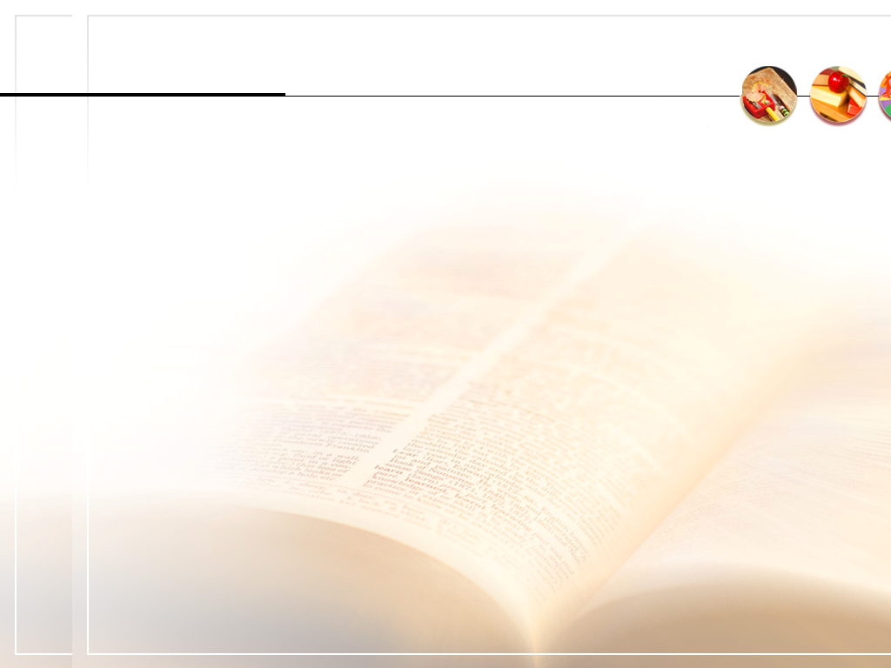

Drilling the structures
Just do it !
Let me try !

Slide 31

Task 1
Fill in blanks

Slide 32
1.The man was in the USA. He wanted to see the man.
(who/ whom/ that)
= The man ______________ he wanted to see was in the USA.
2.Have you seen the film? I saw it yesterday.
= Have you seem the film ___________ I saw yesterday?
(that/ which)
3.Do you know the girl? Her mother is talking to Cal?.
whose
Do you know the girl ________ mother is talking to Cal?
4.Rose lives in a room. Its window faces south.
whose
= Rose lives in a room ________ window faces south.

Slide 33
1.The man was in the USA. He wanted to see the man.
who/ whom/ that
= The man ______________ he wanted to see was in the USA.
2.Have you seen the film? I saw it yesterday.
= Have you seem the film ___________ I saw yesterday?
(that/ which)
3.Do you know the girl? Her mother is talking to Cal.
whose
Do you know the girl ________ mother is talking to Cal?
4.Rose lives in a room. Its window faces south.
whose
= Rose lives in a room ________ window faces south.

Slide 34
Task 2
Correct the sentences:

Slide 35
Correct the sentences:
1. I’m using the pen which he bought it yesterday.
2. The man whom I spoke is from Canada.
3. July 1,1999 is the day when we’ll never forget.
∧
to
that

Slide 36
Correct the sentences:
4. I’m going to work in the hospital where needs me.
5. Those that haven’t been to the West Lake will gather at the school gate.
which
who

Slide 37
Correct the sentences:
6.This is the last time when I’ve given you lessons.
7. Taiwan, that we know, belongs to China.
that
as

Slide 38
Correct the sentences:
8. Miss Chen is the only one of the few teachers who give us wonderful English lessons in our school.
gives

Slide 39
Correct the sentences:
9. Taiwan, that we know, belongs to China.
10.The bike by which I travelled was his.
as
on

Slide 40

Task3. Writing
My Best friend

Slide 41
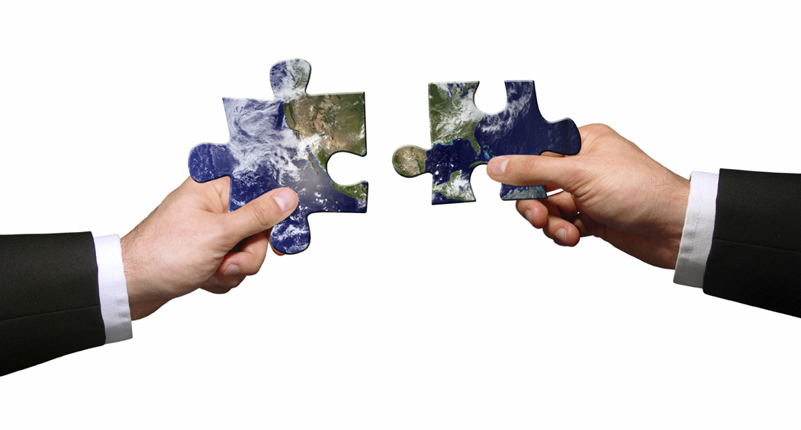
Example:
who is wearing a blue blouse
The girl … is my best friend in our class.
Who is she?

Slide 42
1.Please write a short passage of five sentences to describe your best friend, using the attributive clauses.
2.Then swap your writing with your partner, check his/her punctuation ,spelling and grammar.

Slide 43
Sample writing:
I have a very good friend in our class. Do you know who she is? She is the girl who likes English very much and is good at it. Her dream is to be an interpreter, which will enable her to travel around the world. She often says , “He who doesn’t reach the Great Wall isn’t a true man”.

Slide 44

What have we learnt in this class?
We have learnt the attributive clauses.
定语从句的基本概念 、含义、句法作用及在句子中的位置、先行词、关系代词等，关系词的作用。
Bear them in your mind!

Slide 45

Homework
1.Revise the grammar we learnt in this class。
2.Finish the exercises on P29 and P64.
3.Correct your writing and do it in your exercise books and
hand them in today.
Discussion
If you are going with Wang Kun and Wang Wei, you can only take three things. what will you take and why?

Slide 46

Thank you!

